Slide 1
State, rememberSaveable, and ViewModel
Mobile Application Development
Ir. Aryo Pinandito, Ph.D.

Slide 2
State

Slide 3
State
State in an app is any value that can change over time, encompasses everything from a Room database to a variable in a class.
All Android apps display state to the user, e.g.:
A Snackbar that shows network connection status.
A blog post and associated comments.
Ripple animations that play when a user clicks.
Stickers that a user can draw on top of an image.
Jetpack Compose helps developers be explicit about where and how to store and use state in an Android app.

Slide 4
State and Composition
Compose is declarative and as such the only way to update it is by calling the same composable with new arguments.
These arguments are representations of the UI state.
Any time a state is updated a recomposition takes place.
As a result, things like TextField don’t automatically update like they do in imperative XML based views.
A composable has to explicitly be told the new state in order for it to update accordingly.

Slide 5
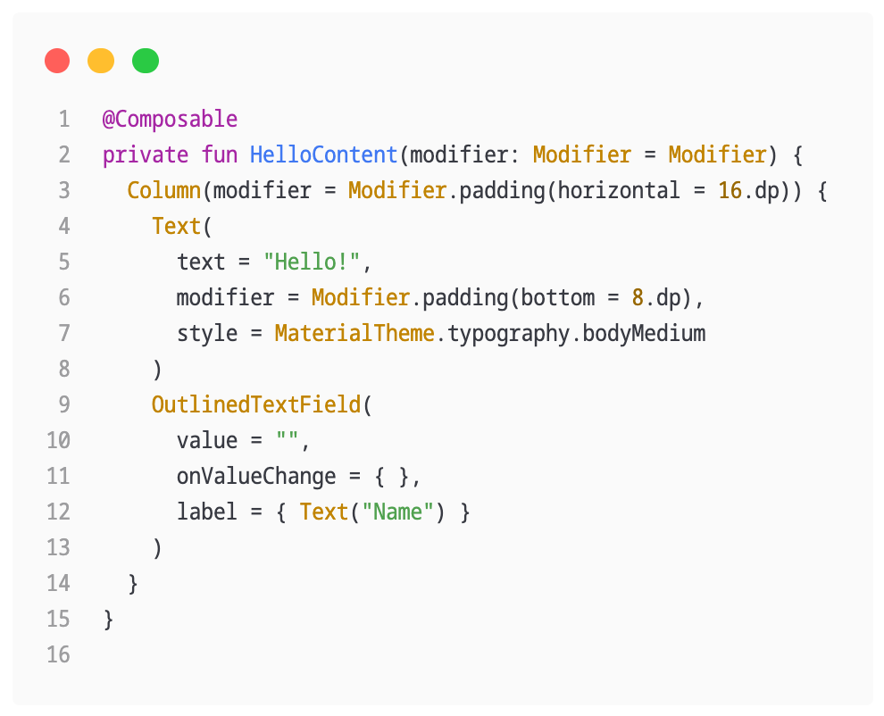
Try to enter text, nothing will happen.
TextField doesn't update itself—it updates when its value parameter changes.
This is due to how composition and recomposition work in Compose.

Slide 6
State in Composable
Composable functions can use the remember API to store an object in memory.
A value computed by remember is stored in the Composition during initial composition, and the stored value is returned during recomposition.
remember can be used to store both mutable and immutable objects.
remember stores objects in the Composition, and forgets the object when the composable that called remember is removed from the Composition.

Slide 7
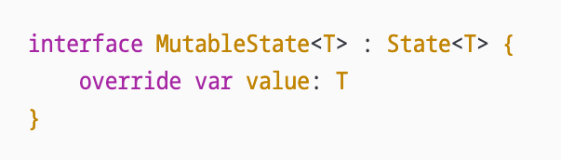
MutableState<T>
mutableStateOf creates an observable MutableState<T>, which is an observable type integrated with the compose runtime.
Any changes to value schedules recomposition of any composable functions that read value.

Slide 8
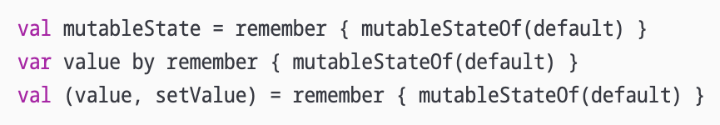
Declare a MutableState object
These declarations are equivalent, and are provided as syntax sugar for different uses of state.
Pick the one that produces the easiest-to-read code in the composable.
Notes:
These declarations are equivalent, and are provided as syntax sugar for different uses of state. You should pick the one that produces the easiest-to-read code in the composable you're writing.

Slide 9
Using by Delegate
The by delegate syntax requires the following imports:
import androidx.compose.runtime.getValue
import androidx.compose.runtime.setValue

Slide 10
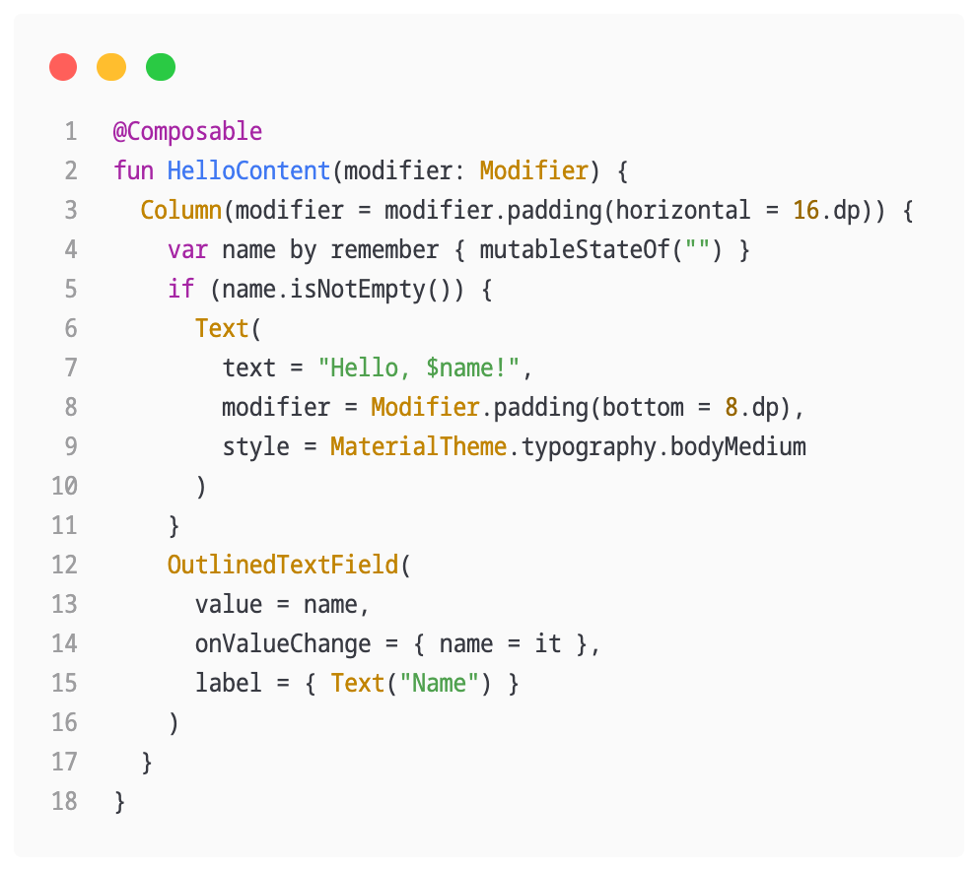

Slide 11
onValueChanged = onChanged(value) { ... }
onValueChanged = {
nilai -> name = nilai
}
onValueChanged = { name = it }

Slide 12
rememberSaveable
While remember helps you retain state across recompositions, the state is not retained across configuration changes.
e.g., screen orientation rotation
For this, use rememberSaveable.
rememberSaveable automatically saves any value that can be saved in a Bundle.
For other values, pass in a custom Saver object.

Slide 13
Saver
A Saver helps rememberSaveable store and restore complex objects by converting them into a format that can be saved into a Bundle (e.g., a Map or List).
Create a data class or object for your state.
Write a Saver that converts the object into a savable format and restores it when needed.
Pass the Saver to rememberSaveable to manage the custom object’s state.

Slide 14
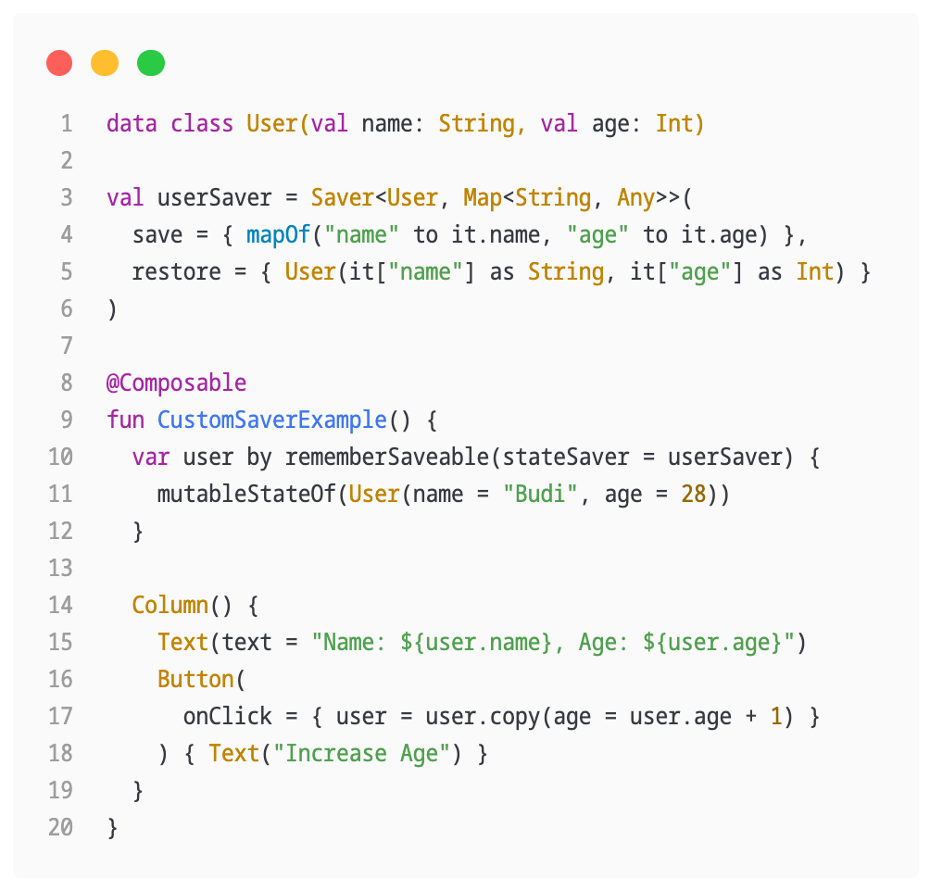
Saver Example
data class for the state
Saver object that converts state object data
Pass Saver object to rememberSaveable

Slide 15
Stateful vs Stateless
A composable that uses remember to store an object creates internal state, making the composable stateful.
This is useful in situations where a caller doesn't need to control the state and can use it without having to manage the state themselves.
However, composables with internal state tend to be less reusable and harder to test.

Slide 16
Stateful vs Stateless
A stateless composable is a composable that doesn't hold any state. An easy way to achieve stateless is by using state hoisting.
To develop reusable composables, it is required to expose both a stateful and a stateless version of the same composable.
The stateful version is convenient for callers that don't care about the state, and the stateless version is necessary for callers that need to control or hoist the state.

Slide 17
State Hoisting
State hoisting in Compose is a pattern of moving state to a composable's caller to make a composable stateless.
The general pattern for state hoisting in Jetpack Compose is to replace the state variable with two parameters:
value: T: the current value to display
onValueChange: (T) -> Unit: an event that requests the value to change, where T is the proposed new value

Slide 18
State Hoisting
State that is hoisted has some important properties/benefits:
Single source of truth
Encapsulated
Shareable
Interceptable
Decoupled
Notes:
State that is hoisted this way has some important properties:
Single source of truth: By moving state instead of duplicating it, we're ensuring there's only one source of truth. This helps avoid bugs.
Encapsulated: Only stateful composables can modify their state. It's completely internal.
Shareable: Hoisted state can be shared with multiple composables. If you wanted to read name in a different composable, hoisting would allow you to do that.
Interceptable: callers to the stateless composables can decide to ignore or modify events before changing the state.
Decoupled: the state for the stateless composables may be stored anywhere. For example, it's now possible to move name into a ViewModel.

Slide 19
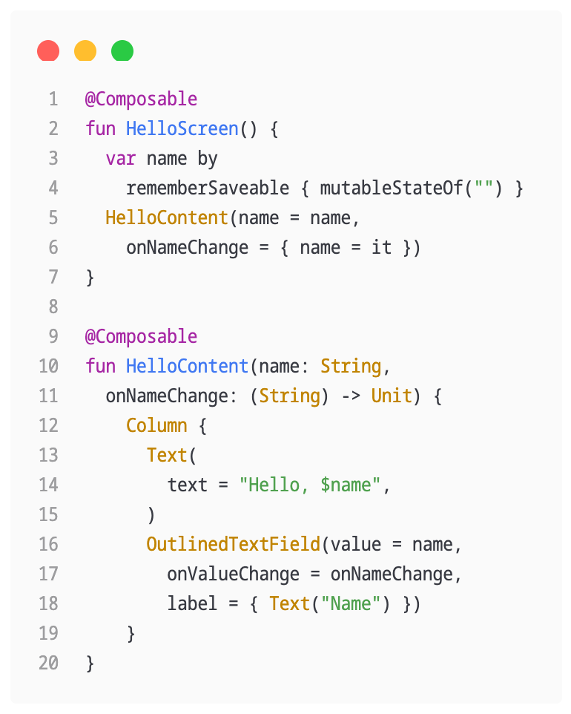
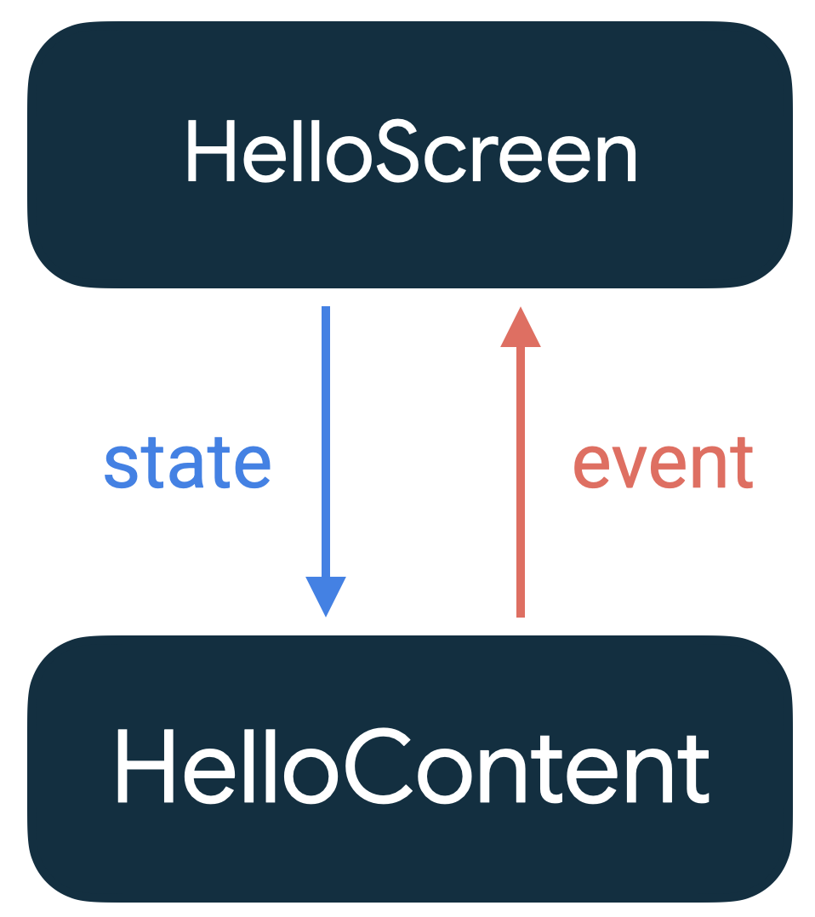
The pattern where the state goes down, and events go up is called a unidirectional data flow.
In this case, the state goes down from HelloScreen to HelloContent and events go up from HelloContent to HelloScreen.

Slide 20
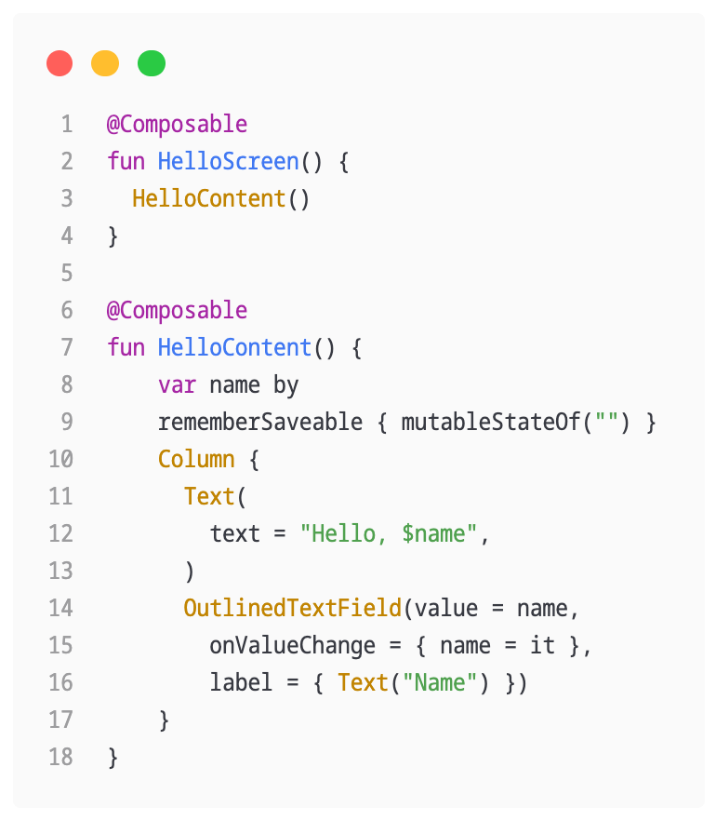

Without state hoisting
With state hoisting
State and event handling are tightly coupled to the composable

Slide 21
App Architecture and ViewModel

Slide 22
Separations of Concerns
The separation of concerns design principle states that the app is divided into classes of functions, each with separate responsibilities.
The drive UI from a model principle states that UI is driven from a model, preferably a persistent model.
Models are components responsible for handling the data for an app.
They're independent from the UI elements and app components in the app, so they're unaffected by the app's lifecycle and associated concerns.

Slide 23
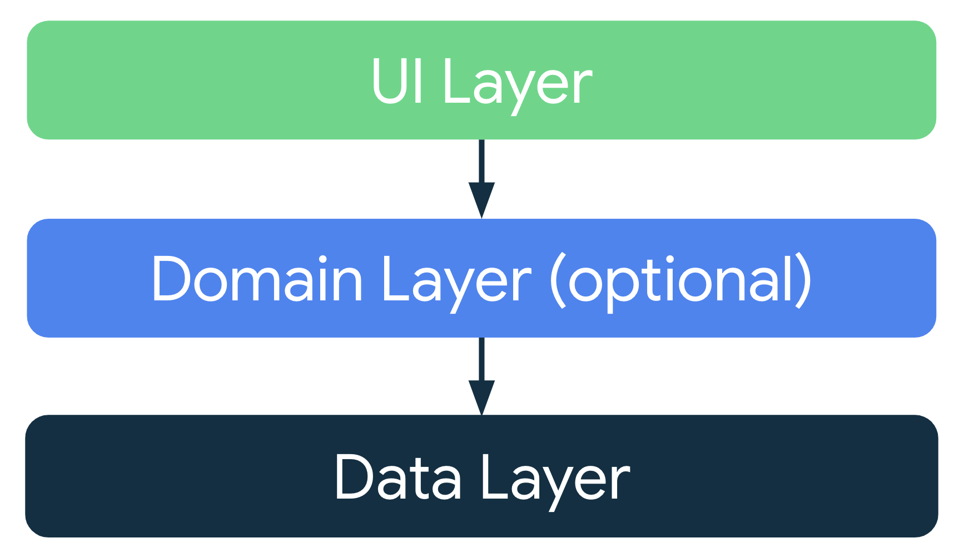
Recommended App Architecture
Considering the common architectural principles, each app should have at least two layers:
UI layer: a layer that displays the app data on the screen but is independent of the data.
Data layer: a layer that stores, retrieves, and exposes the app data.
Domain layer can be added to simplify and reuse the interactions between the UI and data layers.

Slide 24
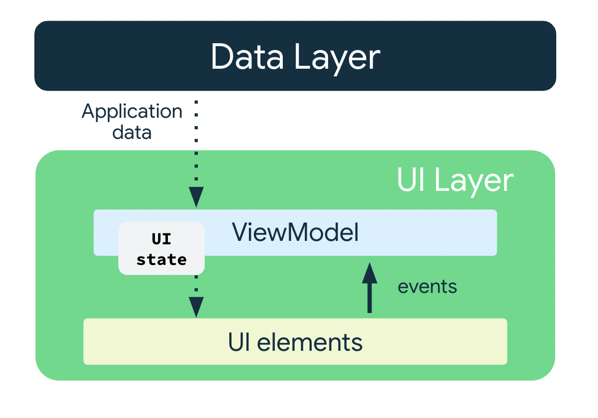
UI Layer
The role of the UI layer, or presentation layer, is to display the application data on the screen.
Whenever the data changes due to a user interaction, such as pressing a button, the UI should update to reflect the changes.

Slide 25
UI Layer
The UI layer is made up of the following components:
UI elements: components that render the data on the screen and build these elements using Jetpack Compose.
State holders: components that hold the data, expose it to the UI, and handle the app logic. An example state holder is ViewModel.

Slide 26
ViewModel
The ViewModel component holds and exposes the state the UI consumes. The UI state is application data transformed by ViewModel.
ViewModel lets the app follow the architecture principle of driving the UI from the model.
ViewModel stores the app-related data that isn't destroyed when the activity is destroyed and recreated by the Android framework.

Slide 27
ViewModel
Unlike the activity instance, ViewModel objects are not destroyed.
The app automatically retains ViewModel objects during configuration changes so that the data they hold is immediately available after the recomposition.
To implement ViewModel in your app, extend the ViewModel class, which comes from the architecture components library and stores app data within that class.

Slide 28

UI State
UI is a result of binding UI elements on the screen with the UI state.
The UI is what the user sees, and the UI state is what the app says they should see.
The UI is the visual representation of the UI state.
Any changes to the UI state immediately are reflected in the UI.

Slide 29
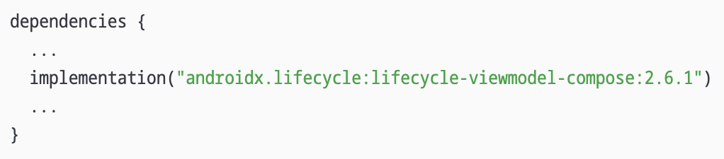
Add a ViewModel
Adding dependencies in module :app build.gradle file.

Slide 30
Add a ViewModel
Create AppViewModel class that extends ViewModel class.
class AppViewModel : ViewModel() { // ... }

Slide 31
Add a Model Data Class
Add a model class for state UI called AppUiState.
Make it a data class and add a variable for the current counter.
data class AppUiState( val counter: Int = 0 )

Slide 32
StateFlow
StateFlow is a data holder observable flow that emits the current and new state updates. Its value property reflects the current state value.
To update state and send it to the flow, assign a new value to the value property of the MutableStateFlow class.
In Android, StateFlow works well with classes that must maintain an observable immutable state.
A StateFlow is exposed from the AppUiState so that the composables can listen for UI state updates and make the screen state survive configuration changes.

Slide 33
Backing Property
A backing property let ViewModel return something from a getter other than the exact object.
For var property, the Kotlin framework generates getters and setters.
For getter and setter methods, one or both of these methods can be overridden and provide a custom behavior.
To implement a backing property, override the getter method to return a read-only version of your data.

Slide 34
Backing Property Example
The following example shows a backing property:
// Declare private mutable variable that can only be modified // within the class it is declared. private var _count = 0 // Declare a public immutable field and override its getter method. // Return the private property's value in the getter method. // When count is accessed, the get() function is called and // the value of _count is returned. val count: Int get() = _count

Slide 35
Adding StateFlow in ViewModel
In the AppViewModel class, add the _uiState property and uiState backing property.
import kotlinx.coroutines.flow.MutableStateFlow // App UI state private val _uiState = MutableStateFlow(AppUiState()) val uiState: StateFlow<AppUiState> = _uiState.asStateFlow()

Slide 36
Adding init() and reset() Function
// Reset when ViewModel is instatiated
init {
reset()
}
// Reset the counter
fun reset() { _uiState.value = AppUiState(counter = 0)
}

Slide 37
Adding addCounter() Function
// Get state counter value
// and update the state with a new counter value
fun addCounter() {
val count = _uiState.value.counter + 1
_uiState.update {
currentState -> currentState.copy(
counter = count
)
}
}

Slide 38
Architecting Compose UI
In Compose, the only way to update the UI is by changing the state of the app.
What to control is the UI state.
Every time the state of the UI changes, Compose recreates the parts of the UI tree that changed.

Slide 39
Architecting Compose UI
Composables can accept state and expose events, for example, a TextField/OutlinedTextField accepts a value and exposes a callback onValueChange that requests the callback handler to change the value.
var name by remember { mutableStateOf("") }
OutlinedTextField(
value = name,
onValueChange = { name = it },
label = { Text("Name") }
)

Slide 40
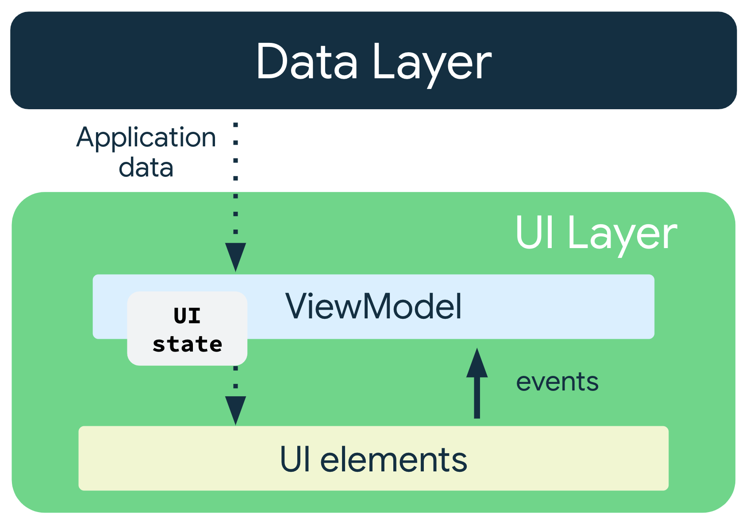
Unidirectional Data Flow
A unidirectional data flow (UDF) is a design pattern in which state flows down and events flow up.
By following unidirectional data flow, composables can be decoupled that display state in the UI from the parts of your app that store and change state.

Slide 41
Unidirectional Data Flow
The UI update loop for an app using unidirectional data flow looks like the following:
Event: Part of the UI generates an event and passes it upward—such as a button click passed to the ViewModel to handle—or an event that is passed from other layers of the app, such as an indication that the user session has expired.
Update state: An event handler might change the state.
Display state: The state holder passes down the state, and the UI displays it.

Slide 42
UDF Implications
The ViewModel holds and exposes the state the UI consumes.
The UI state is application data transformed by the ViewModel.
The UI notifies the ViewModel of user events.
The ViewModel handles the user actions and updates the state.
The updated state is fed back to the UI to render.
This process repeats for any event that causes a mutation of state.

Slide 43
Passing Data
Pass the ViewModel instance to the UI–that is, from the AppViewModel to the AppScreen() composable.
In the AppScreen(), use the ViewModel instance to access the uiState using collectAsState().

Slide 44
Passing Data
import androidx.lifecycle.viewmodel.compose.viewModel
@Composable
fun AppScreen(
appViewModel: AppViewModel = viewModel()
) {
val appUiState by
appViewModel.uiState.collectAsState()
Text(text = appUiState.counter.toString())
...
}

Slide 45
Passing Event to ViewModel
...
Button(onClick = { appViewModel.addCounter() }) {
Text("Add Counter")
}
Button(onClick = { appViewModel.reset() }) {
Text("Reset")
}
...

Slide 46
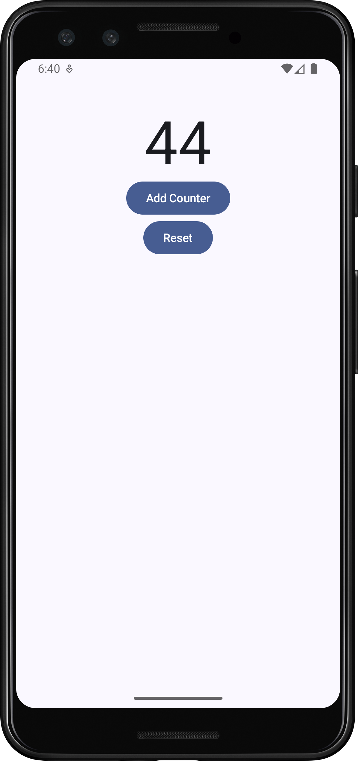
Click Add Counter to increase the counter
Click Reset to reset the counter to zero

Slide 47
Questions?

Slide 48
Assignments

Slide 49
Assignment
Buat sebuah form input data menggunakan Jetpack Compose.
Dianjurkan menggunakan/membuat form yang akan digunakan untuk project akhir mata kuliah.
Buatlah sebuah mekanisme validasi setiap elemen input yang digunakan dengan menggunakan ViewModel
Buat sebuah proses/submit data di mana data yang dimasukkan pengguna diolah/digabungkan dari dua atau lebih input yang berbeda.
Contoh: nama, gabungan dari nama depan dan nama belakang

Slide 50
Assignment
Rekam video yang mendemokan assignment ini dalam durasi maksimal 60 detik.
Di dalam demo program yang dibuat, tunjukkan bahwa data isian yang sudah dimasukkan oleh pengguna tidak hilang ketika orientasi layar berubah.
Submit link video (di-upload di online storage, seperti Google Drive) DAN link source code aplikasi dalam bentuk repository GitHub melalui Google Classroom assignment ini.
Tugas ini bersifat perorangan.

